Slide 1

UC Davis ECE Graduate Program Information Session
Learn about UC Davis ECE Graduate programs
Learn about UC Davis ECEGP Faculty and research opportunities
Learn abut the application process
Get your questions answered

Slide 2

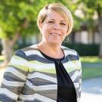
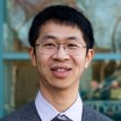
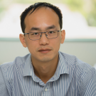
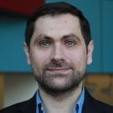
Graduate Advising Team
Michelle Walker
Graduate Program Coordinator
Main point of contact
Reviews all paperwork
Academic Advising
Funding Questions
Faculty and/or student concerns
Professor Weijian Yang
Graduate Faculty Advisor
Academic Advising
Approvals
  Remedial Courses
  Program of Study
  Grad Studies Paperwork
  ECE Paperwork
  Faculty and/or student concerns
Professor Lifeng Lai
ECE Graduate Program Chair
Approves Petition to Change Degree Objective
Faculty and/or student concerns
Professor Sebastian Gomez-Diaz
MS Advising Director
MS Advising
Approvals
Faculty and/or student concerns
Notes:
Michelle presents the Graduate Advising Team. Sacksith introduces Professor Lai.

Slide 3
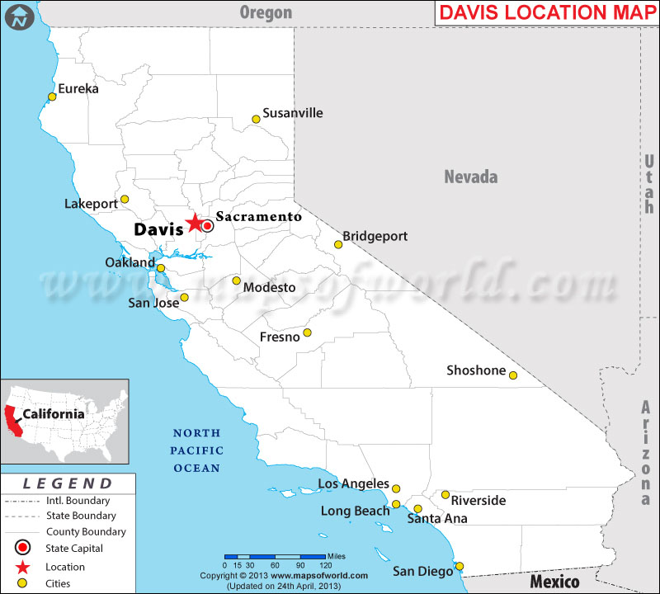
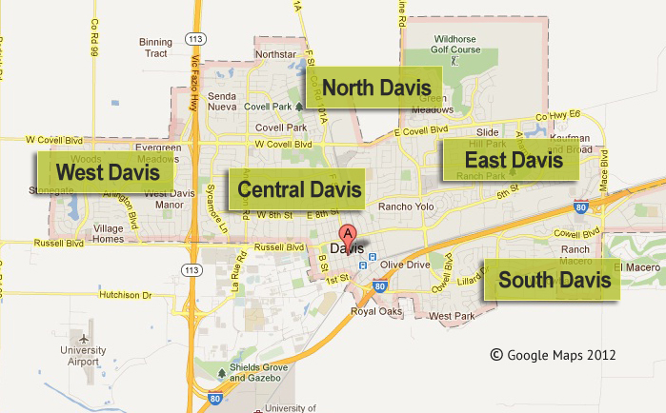
A brief intro to Davis and the Department

Slide 4



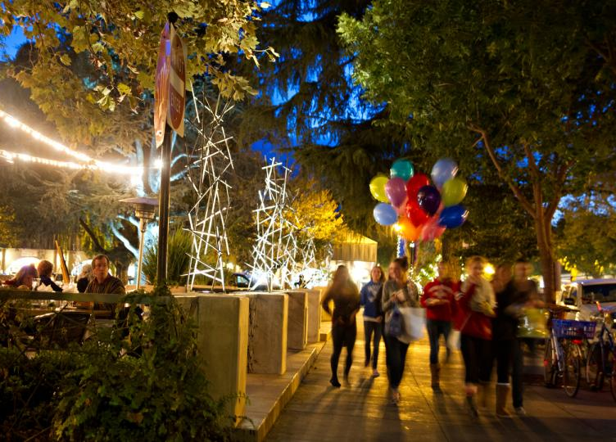
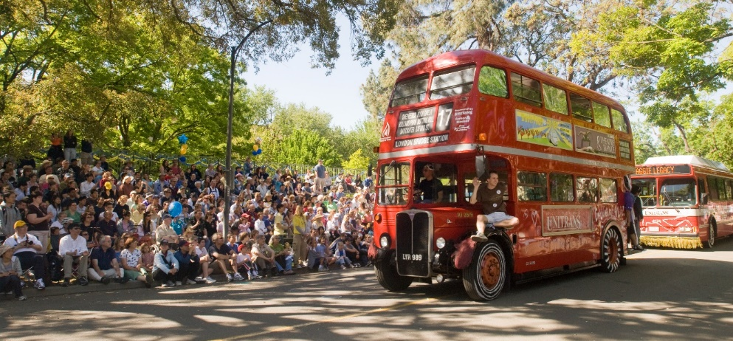
Around Davis

Slide 5


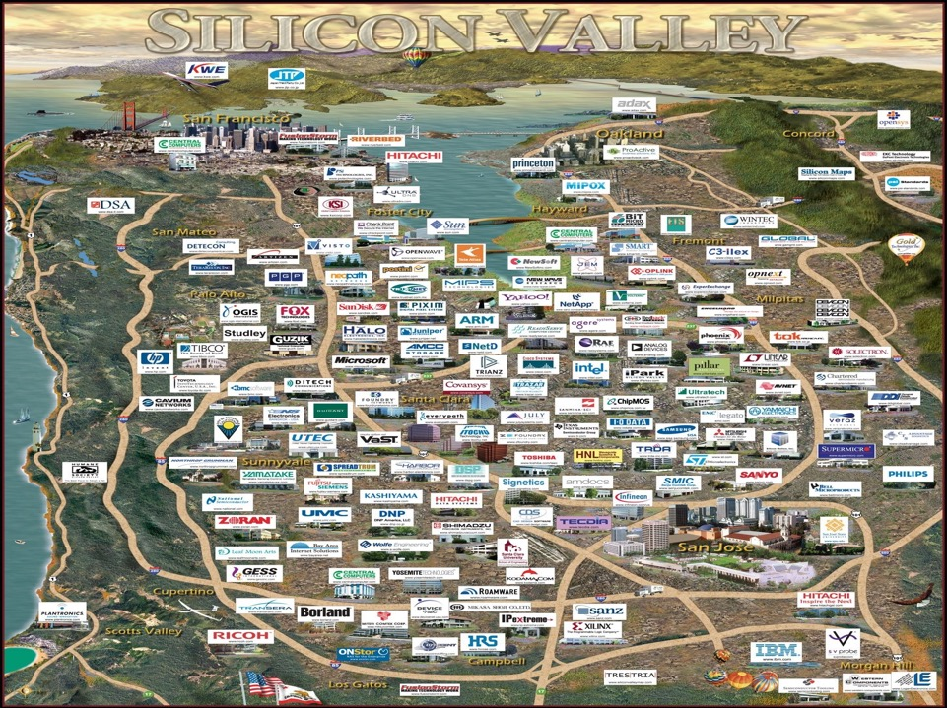


Near Davis
Tahoe Lake
Napa Valley
San Francisco
Yosemite National Park

Slide 6
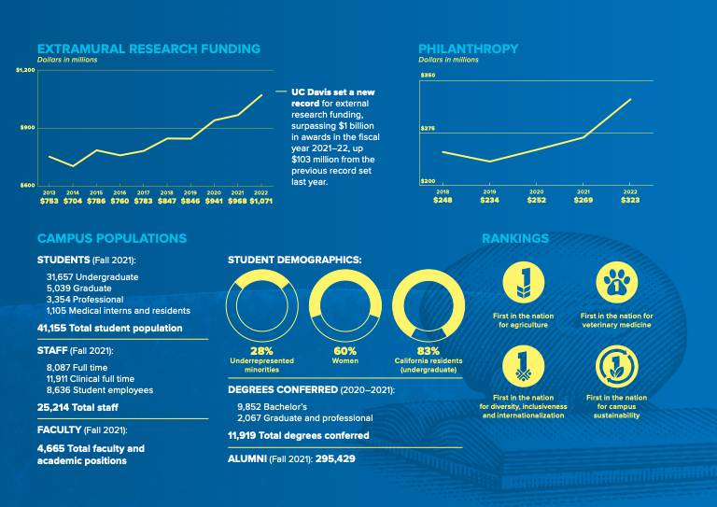
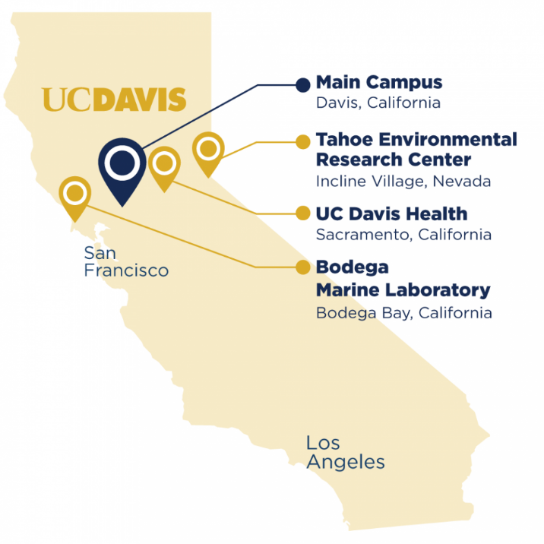
Notes:
Some fun facts of UC Davis. The central campus is closed to motor vehicles, and bicycles are the main means of transportation on campus.
On a normal campus day, the estimate is there are 22,000 bicycles on campus.

Slide 7
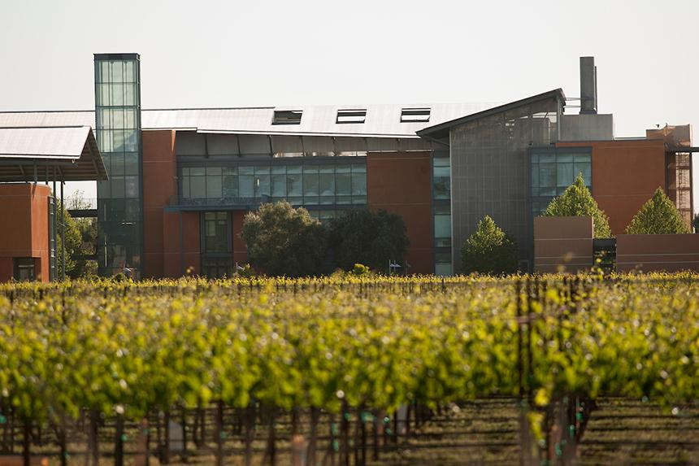
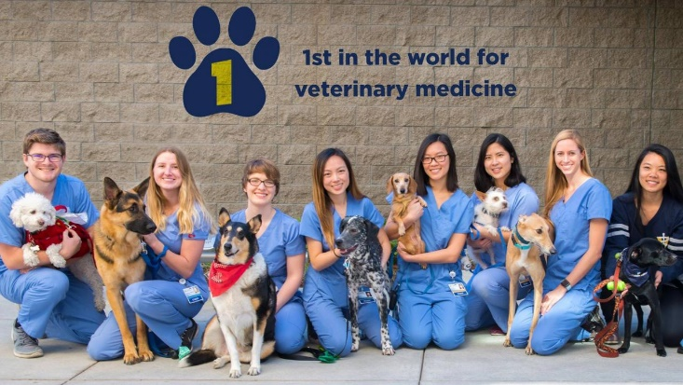
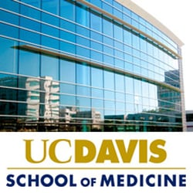
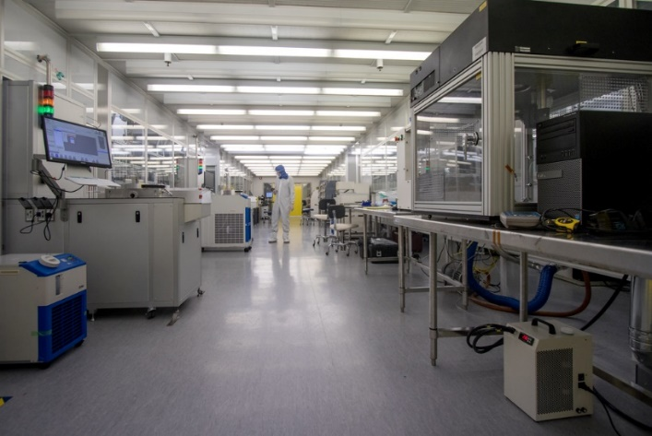

Campus
Mondavi Wine Institute
Center for Nano/Micro-Manufacturing

Slide 8
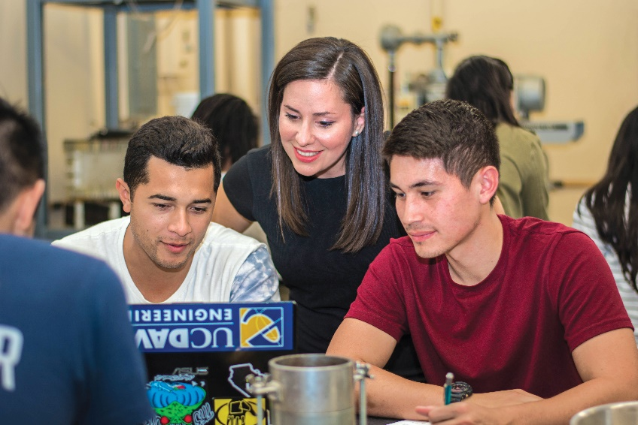
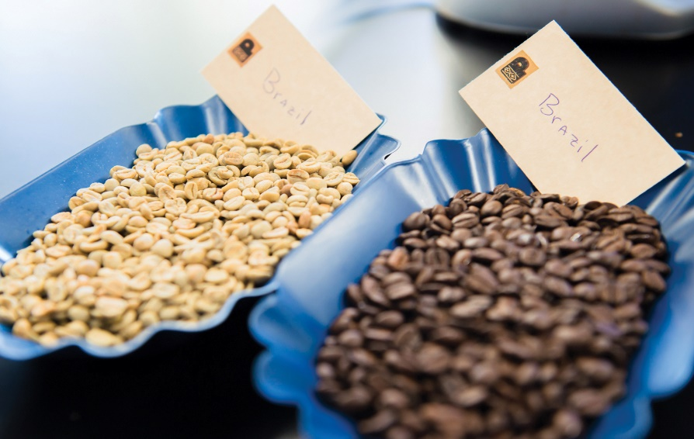
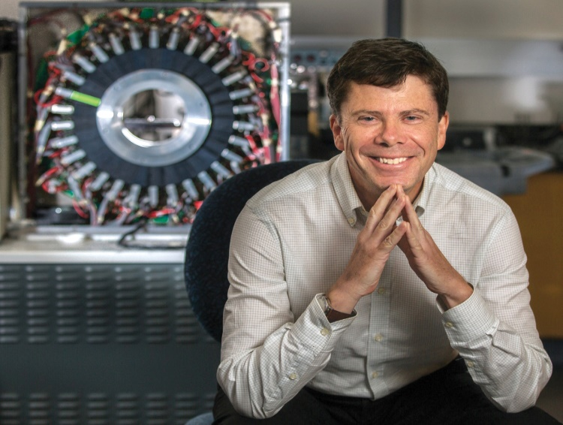
UC Davis College of Engineering Highlights
1
1
1
#
Percent of Women Faculty Among Top 50 Engineering Programs
– American Society for Engineering Education
ST
Post-Harvest Coffee Research Center in the U.S.
ST
Full-Body PET/CT Scanner in the World, EXPLORER

Slide 9
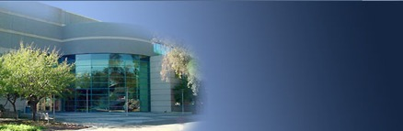

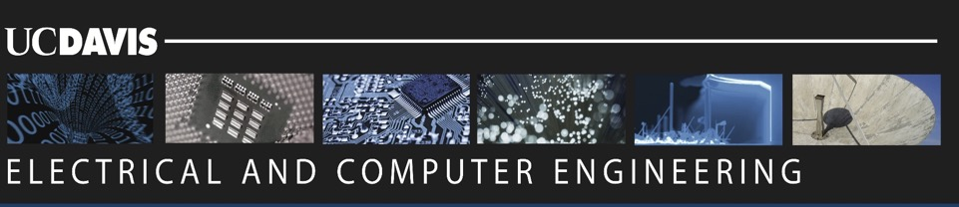
ECE Department
ELECTRICAL & COMPUTER
ENGINEERING

Slide 10
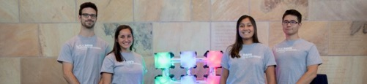
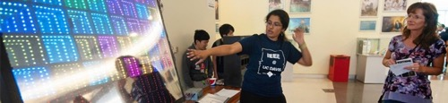
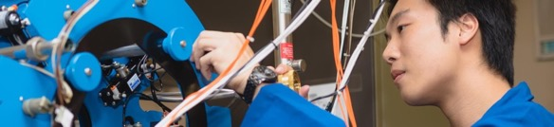

ECE department
  ~800 Undergraduate Students
 | New Students + Deferrals | Current Students | Total
PhD | 18 | 134 | 152
MS | 71 | 82 | 153
Total | 89 | 216 | 305

Slide 11


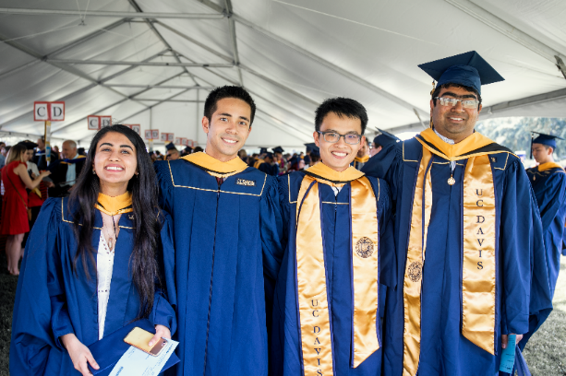











UC Davis ECEGP Alumni

Slide 12
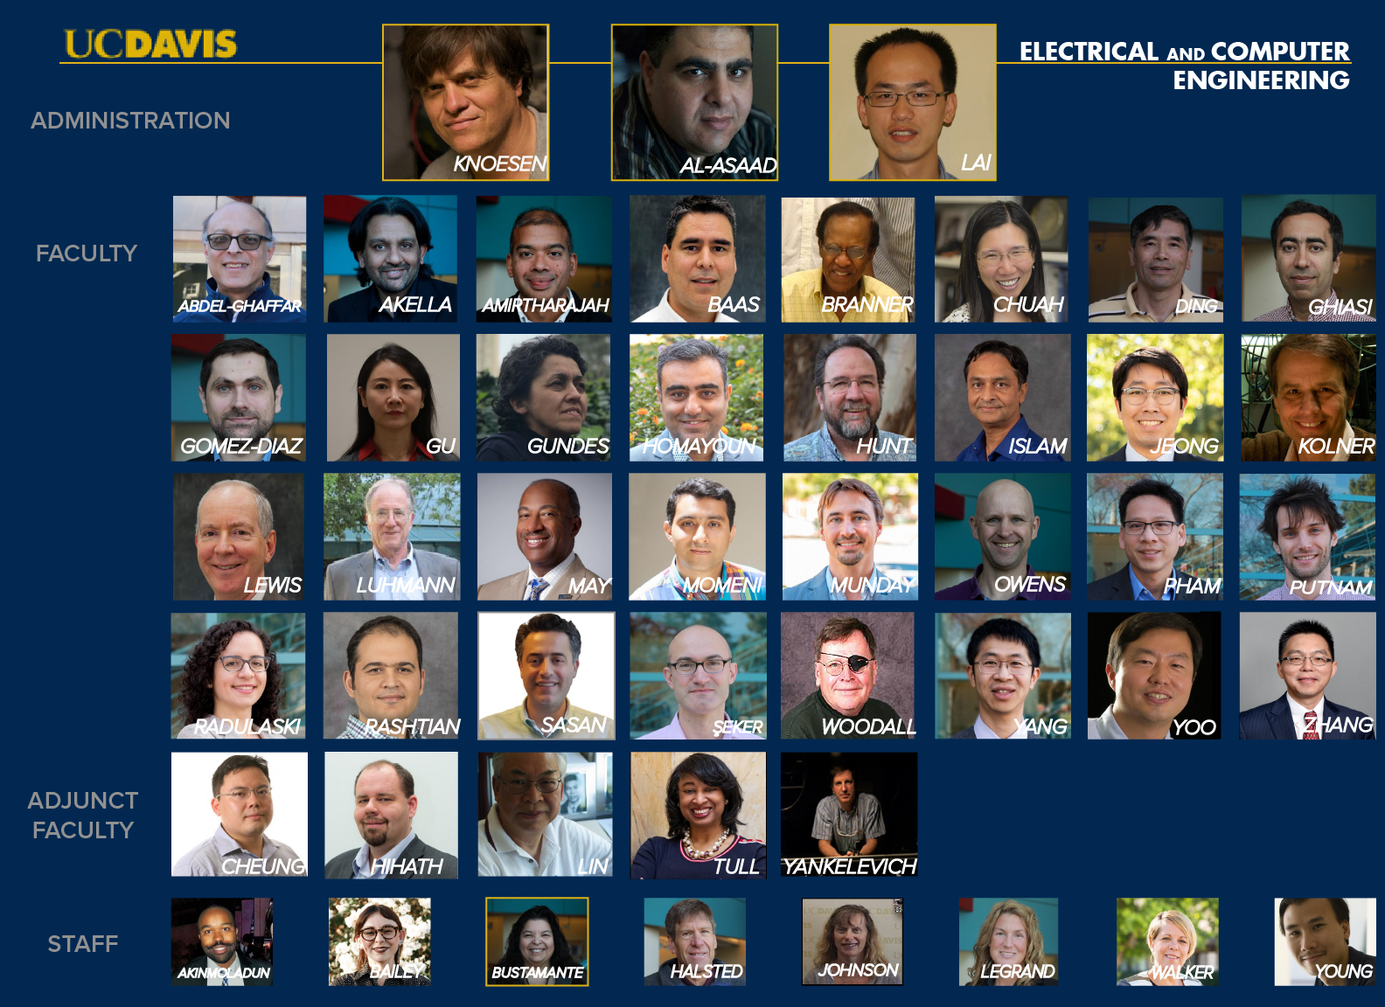
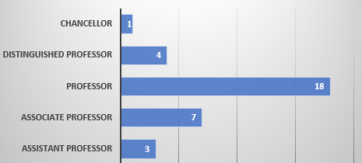
35 Tenured/Tenure-Track faculty
2023 US News Graduate School National Institutional Rankings:
Electrical Engineering:
Top 6% among 185 public universities
Computer Engineering:
Top 7% among 147 public universities
Many prestigious recognitions, including 4 National Academy of Engineering members, 19 (8 during last 5 years) NSF CAREER awards , and fellows in important professional societies such as IEEE and American Physical Society.
Notes:
We have 35 tenure or tenured track faculty in the department, and the distribution among the ranks is shown on the right. For the last 10 years, we are the only department on the campus that can claim having a Chancellor in our department.

Slide 13
Weijian Yang
Notes:
The faculty are the recipients of many prestigious recognitions, including 4 National Academy of
Engineering members, 17 NSF CAREER awards, and fellows in important professional societies such as
IEEE and American Physical Society.

Slide 14
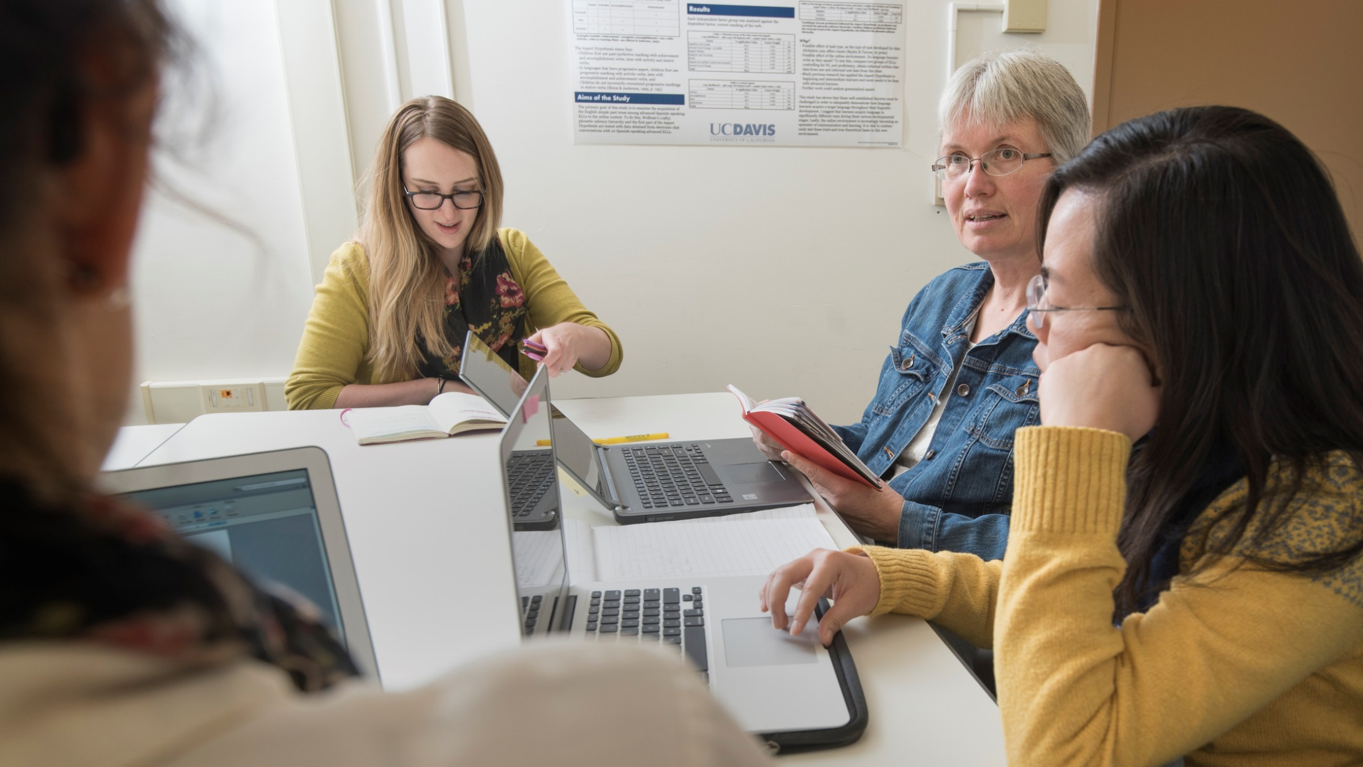
GRADUATE GROUPS
More than half of our graduate programs are organized as interdisciplinary graduate groups, giving students and faculty alike the freedom to explore interests across disciplines, engage in various areas of research, and reach new heights of knowledge.
  Check out Graduate Group Faculty from different research areas
Notes:
~25 graduate program faculty (mechanical, chemical, veterinary medicine, school of management, bioag, computer science)

Slide 15

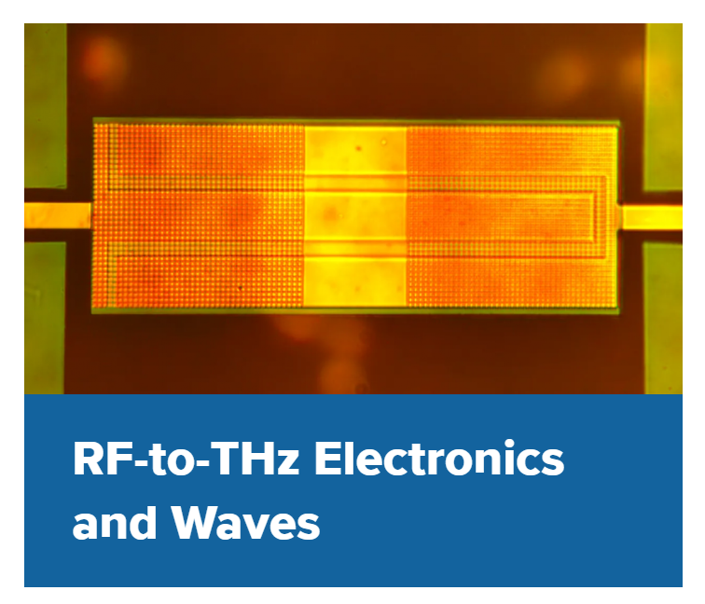
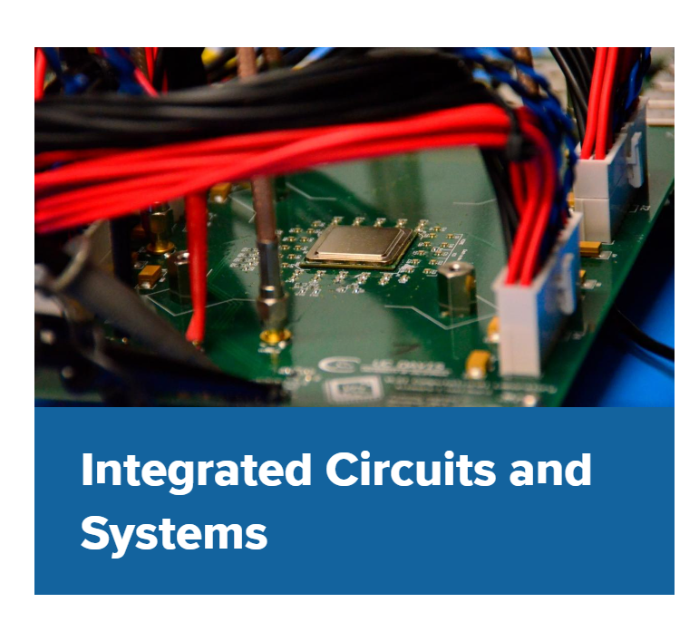
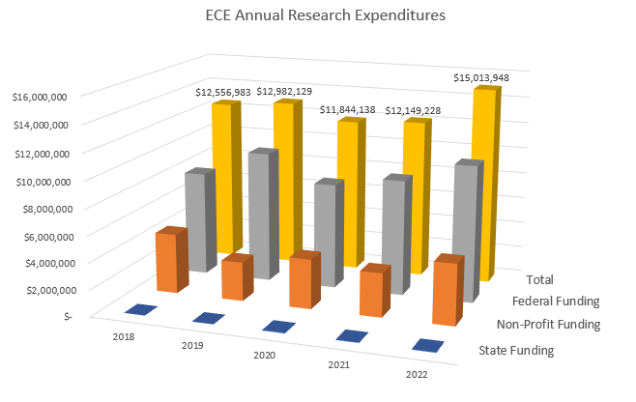
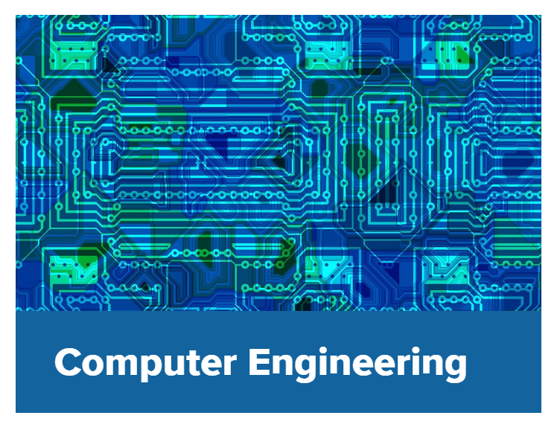
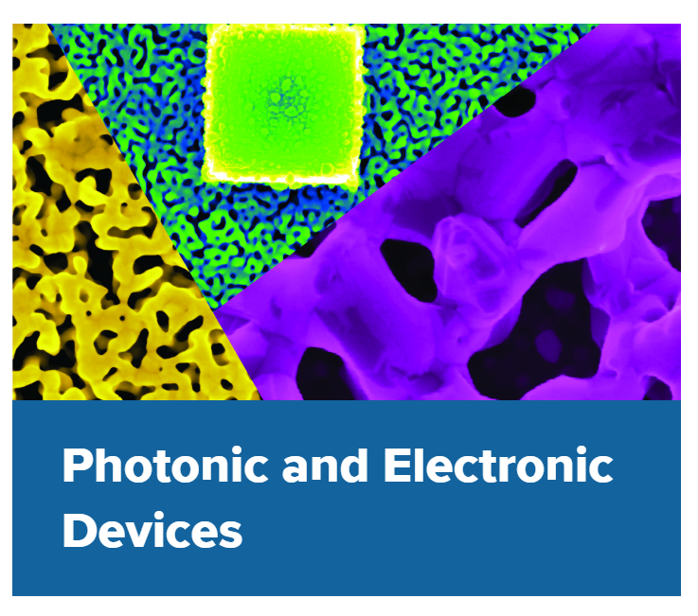
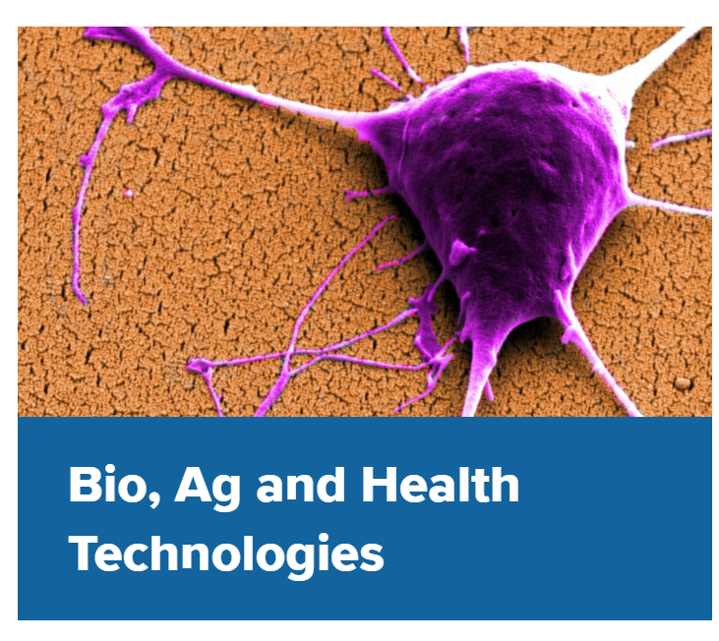


























ECE Research
9 faculty
6 faculty
11 faculty
11 faculty
13 faculty
9 faculty
Federal
Defense
National Labs
Foundations
Industry
Source: ASEE
Etc.
Notes:
Our students are trained within a system engineering framework, because at the core a well-trained ECE must have foundational knowledge in several areas captured in six themes we use at UC Davis: .
The outlier is the Bio, Ag and Health Technologies area and reflects the collaborative research our faculty and student perform taking advantage of strength at UC Davis in biological, agriculture and medical areas.
Funding to support research is the responsibility of the faculty and comes from competitive grants competitions.
The funding sources for research for ECE faculty ranges from Federal to Industry , and such diversity of resources is healthy.
The 2022 ANNUAL research expenditures in ECE was $15M, with a significant portion coming from federal funding and almost none from the state.
$15M annual research expenditures translates to approximate $45M in research contracts that now are actively being managed in ECE.
This year, ECE is experiencing a notable uptick in successful grant and contract awards, so there will be a growth in 2023 research funding.

Slide 16
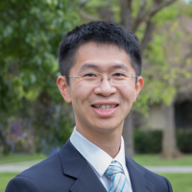
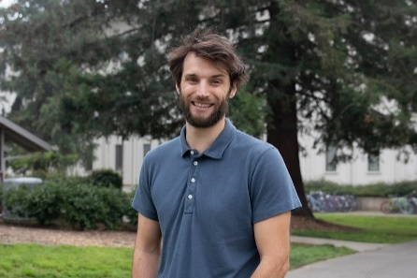
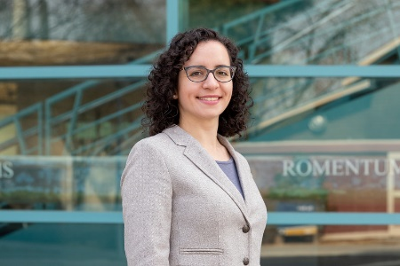
Points of Pride: Excellence of ECE Junior Faculty
Wejian Yang, Associate Professor (2022), joined as Assistant Professor in 2017 (PhD UC Berkeley, 2013)
2016 Burroughs Career Award
2019 NSF Career Award:
Agile multiplexed multiphoton microscope for interrogation of neural circuits.
2021 COE Excellence in Teaching Award in ECE
2021 Science/PINS Neuromodulation Prize Finalist
William Putnam, Assistant Professor, joined in 2018 (PhD MIT, 2015)
2020 COE Excellence in Teaching Award in ECE
2020 Air Force Office of Scientific Research's 2023 Young Investigator:
Superradiant Smith-Purcell Emission in the Mid-Infrared via Guided-Wave Electron Optics
2021 NSF Career Award:
Chip-Scale Field-Resolved Detection of Mid-Infrared Light
Marina Radulaski, Associate Professor (2023), joined as Assistant Professor in 2018 (PhD Stanford, 2017)
2021 NSF Career Award
Scalable Quantum Photonics based on Color Center Integration with Angle-etched Silicon Carbide Devices
2022 Leading Female Researcher Award by One Quantum
2022 COE Excellence in Teaching Award in ECE
2023 Air Force Office of Scientific Research's 2023 Young Investigator
Triangular Photonic Crystals with Integrated Color Centers for Quantum Mesh Photonics in Silicon Carbide
Notes:
I leaving you with Points of Pride. We can only educate students effectively, if we have excellent faculty. Here I showing examples of three junior faculty hired in the last few years who are absolutely hitting the ball out of the park.

Slide 17
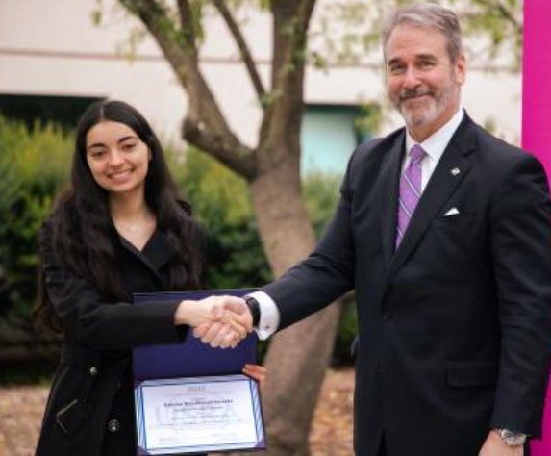
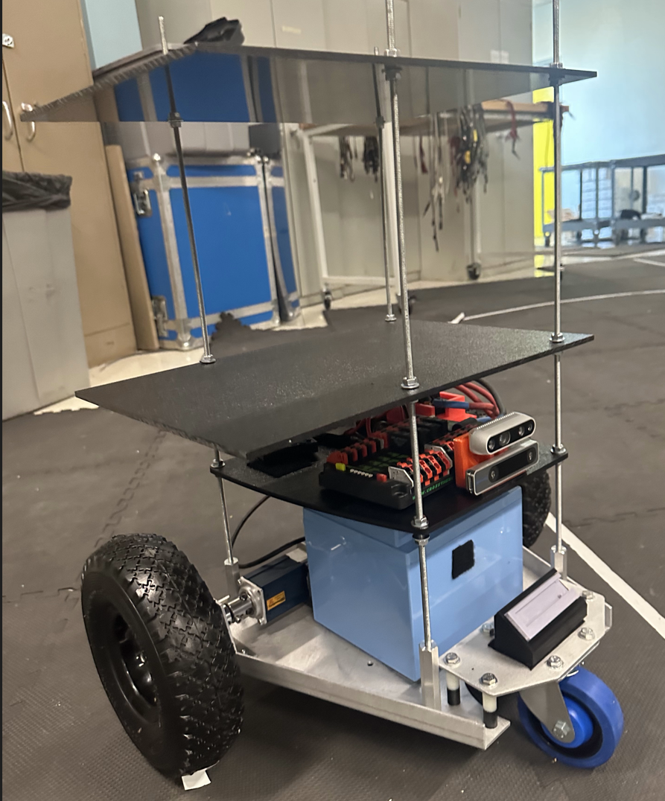
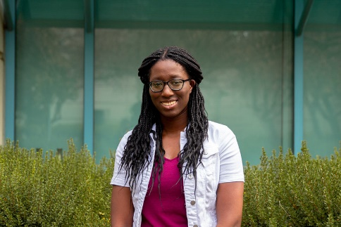
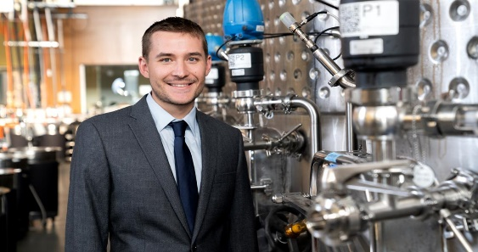
Highest Points of Pride: Our Students
ECE Undergraduate Student:
2023 Universities Space Research Association Distinguished Undergraduate Award
Sabrina Yarzada (double major in electrical engineering and computer engineering), GPA 3.98, IEEE Student Club President)
“Being the first in UC Davis history to be named a USRA Distinguished Undergraduate is an absolute honor,” she said. Noting her humble beginnings, she added, “It is a powerful demonstration of the fact that anyone, from any background, can achieve anything.” Sabrina
Senior Design Project
LLNL Sponsored ECE Student Project: Safety Inspection robot to automatically identify faults in electrical equipment used in NIF (reduce technicians’ exposure to dangerous environments in electric power plants and substations).
ECE Graduate Students: Ph.D. Mulitiyear Fellowships
James Nelson
Toluwa Odemuyiwa
Microsoft Fellowship
Rodgers University ECE Fellowship &
Keller Pathway Fellow, Mike and Renee Child Institute for Innovation and Entrepreneurship, Graduate School of Management
PhD Research: “more efficient for computers -- whether CPUs, GPUs, or new platforms --- to work with sparse data.”
PhD Research: “Advanced Monitoring, Prediction and Control of Wine Fermentation”
“If you look at education today, most things that are state of the art happen at the intersection of two disciplines. Not by one group of professors in one department, but at the collaboration between two or three departments on something”. T J Rodgers
Notes:
I mentioned our department mission is to educate ECE students
* to develop technical innovations in ECE and multi-disciplinary areas through high-impact scholarship and research.
* to train engineers and industry leaders by providing a transformative learning experience and the knowledge necessary to solve significant problems for the high-tech industry.
Here are three of students in ECE:
An undergraduate senior Sabrina Yarzada received the 2023 Universities Space Research Association Distinguished Undergraduate Award, only five such international awards are given out each year.
A PhD sudent Sabrina Odemuyiwa received a highly competitive Microsoft Fellowship.
A PhD student James Nelson, whose PhD is supported by a multiyear Rodgers University ECE Fellowship recently became a Keller Pathway Fellow, in the Mike and Renee Child Institute for Innovation and Entrepreneurship, Graduate School of Management
Sabrina, a first generation student, words speak clearly: “Being the first in UC Davis history to be named a USRA Distinguished Undergraduate is an absolute honor,” Noting her humble beginnings, she added, “It is a powerful demonstration of the fact that anyone, from any background, can achieve anything.” The ECE education she received allowed her to do internships at Jet Propulsion Lab and then at NASA, which led to the award, is now doing her senior project on a safety inspection robot to detect electrical faults at NIF at LLNL.ab.
Toluwa is advancing algorithms to more efficiently solve sparse linear matrix problems in ML by tailoring the algorithms to take advantage of untapped potential of hardware features in in existing computing hardware platforms.
James started as an undergraduate at UC Davis in my research group. His PhD research focuses on sensors and control to change the wine industry . While his research contributions are firmly founded in ECE fundamentals, he contributions requires interacting with disciplines well outside of his ECE comfort zone. He is jointly supervised by faculty members in ECE and Viticulture and Enology. James is now making ground breaking and well recognized contributions to the wine industry and in fact has started a company based on his research.
These are typical students ECE are producing. Our ECE students will continue to be leaders their fields. I am leaving you with a quote from TJ Rodgers, who is funding James’ PhD, “If you look at education today, most things that are state of the art happen at the intersection of two disciplines. Not by one group of professors in one department, but at the collaboration between two or three departments on something”.

Slide 18
Degree Options
PhD
MS Plan I (Thesis)
MS Plan II (Project or Paper Critique)
Remedial courses

Slide 19
Financial Support
Funding | Awards
Graduate Student Researcher (Major Professor) Teaching Assistant Positions Fellowships Dean’s Distinguished Fellowship Dissertation Fellowship Graduate Assistance in Areas of National Need (GAANN) Fellowship | Soohoo-Lee Endowed Fellowship Dorf Outstanding Graduate Student Award Northrop Grumman Graduate Fellowship IEEE Graduate Fellowship Travel Awards

Slide 20
Admissions
GRE NOT required
GPA
  3.2 minimum for ECEGP; 3.0 minimum for UC Davis
TOEFL
  24 or higher on Writing; 23 or higher on Speaking (26 is minimum for TA appointment eligibility)
  Recommended total score: 100 or higher; Minimum total score: 80
How to prepare a successful application
  Recommendation letters
  Personal and research statements
  Correspondence with faculty
Notes:
TOEFL:
• Recommended:
o 24 or higher on Writing portion
o 23 or higher on Speaking Portion (26 is minimum for TA appointment eligibility)
o Total Score: 100 – 105 (or higher) total score
• Minimum Total Score: 80
IELTS:
• Recommended: 7.5 or higher
• OGS admissions minimum: 7.0

Slide 21
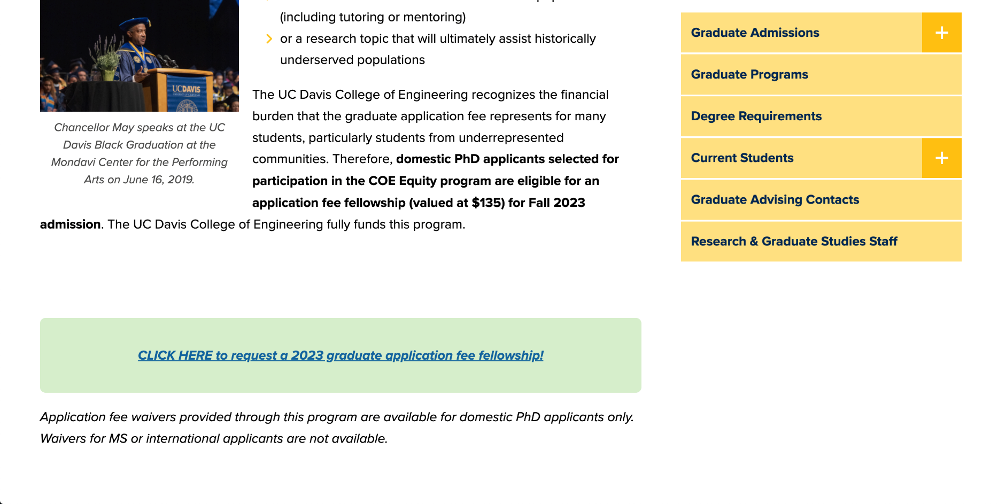
Fee Waiver for Domestic PhD Applicants
https://engineering.ucdavis.edu/graduate-students/admissions/coe-equity-program

Slide 22
PhD Timeline
Year One | Fall Quarter | Winter Quarter | Spring Quarter
 | Declare Major Professor | Preliminary Examination
 | EEC 290: Seminar in ECE | Language Proficiency | Language Proficiency
 | EEC 390: The Teaching of ECE | Courses for Program of Study | Courses for Program of Study
 | Courses for Program of Study
Year Two | EEC 290: Seminar in ECE | Courses for Program of Study | Courses for Program of Study
 | Courses for Program of Study | EEC 299 Research | EEC 299 Research
 | EEC 299: Research
Year Three | Qualifying Exam Preparation | Qualifying Exam Preparation | Qualifying Examination
 | EEC 290: Seminar | Courses for Program of Study | Advancement to Candidacy
 | Courses for Program of Study
Years Four-Six | Dissertation Research and Completion

Slide 23
MS Plan I & MS Plan II Timeline
The work for the Master of Science degree can be completed in three quarters of full-time study, generally 18-24 months of full-time study are required to complete the MS Plan I.
 | MS Plan I | MS Plan II
Select a Major Professor | 1-3 | 1-3
Program of Study & Advancement to Candidacy | 3 | 3
Application for MS Plan I Thesis Committee | 3 | N/A
Application MS Plan II Comprehensive Exam | N/A | 3
MS Plan I Thesis | 6 | NA
MS Plan II Comprehensive Exam | N/A | 5
The nominal durations are displayed as number of academic quarters.

Slide 24
Remedial Courses
Students without a degree in ECE must complete remedial course requirements, obtaining a grade of B or better in six of the courses listed below or their equivalents. The six courses must be selected from at least three of the six areas listed.
Active and Passive Circuits | Electromagnetics
EEC110A Electronic Circuits I EEC110B Electronic Circuits II | EEC130A Introductory Electromagnetics I EEC130B Introductory Electromagnetics II
Physical Electronics | Signals and Systems
EEC140A Principles of Device Physics I EEC140B Principles of Device Physics II | EEC150 Introduction to Signals and Systems I EEC151 Introduction to Signals and Systems II
Computer Engineering | Digital Systems
ECS36A Programming and Problem Solving ECS36B Software Development and Object-Oriented Prog. | EEC170 Introduction to Computer Architecture EEC18 Digital Systems I (formerly EEC 180A) EEC180 Digital Systems II (formerly EEC 180B)

Slide 25
Thank you!!
For any questions, please contact Graduate Program Coordinator Michelle Walker
mtwalker@ucdavis.edu

